Slide 1
COPADS
2023 IFEOLUWATAYO IGE
#1B – Programming C#

Slide 2
Classes
Namespaces
Implicitly typed variables
Accessing files
Exception Handling
Networking
Sample Demo codes

Slide 3
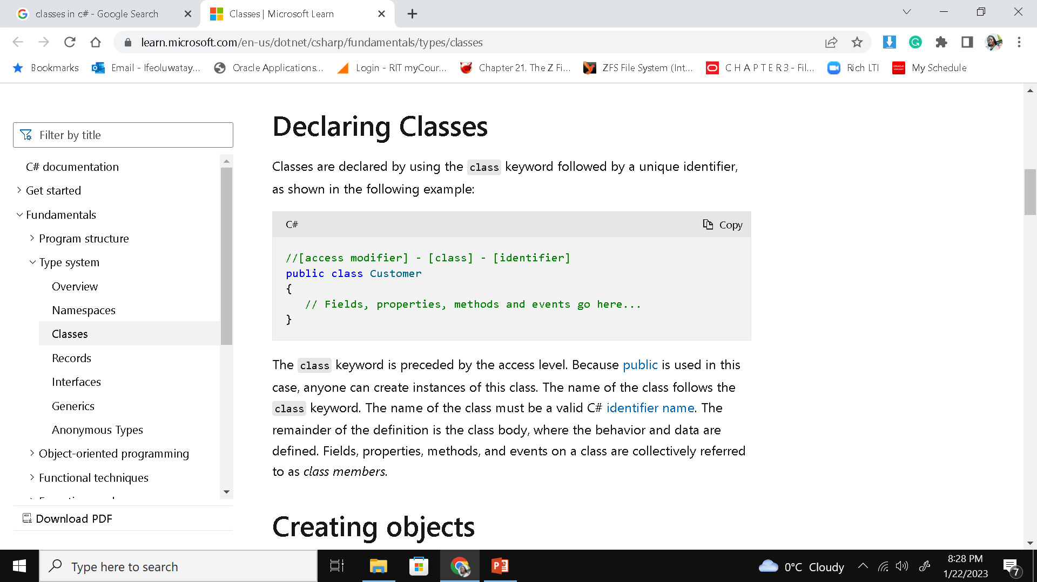
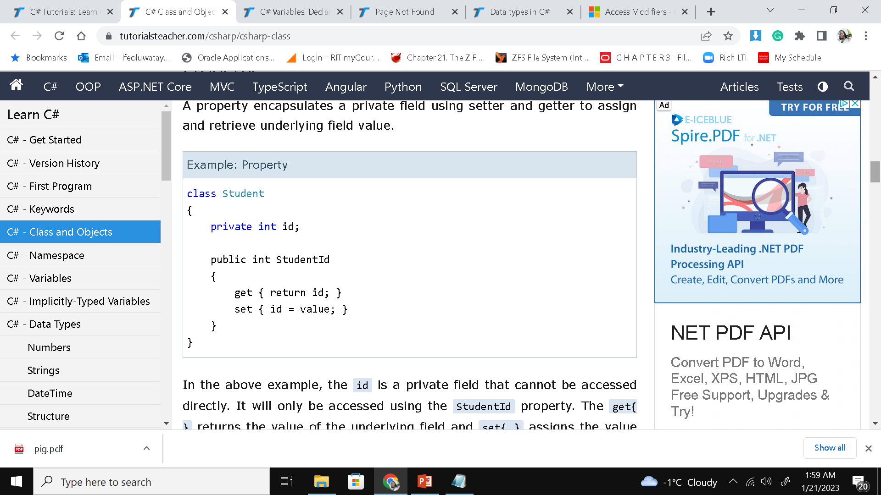
Declaring Classes in C#
Classes can have one or more:
Field (s)- should have a private access modifier used with a property.
property encapsulates a private field using setter and getter to assign and retrieve underlying field value
In the above example, the id is a private field that cannot be accessed directly.
It will only be accessed using the StudentId property.
The get{ } returns the value of the underlying field and set{ } assigns the value to the underlying field id.
Methods-
with void or return value
could have parameters
Access Modifiers can be either:
Private – no one can access
Public – anyone can access
Protected–derived classes can access
A source file may contain multiple public classes
Source file name need not match the class name

Slide 4
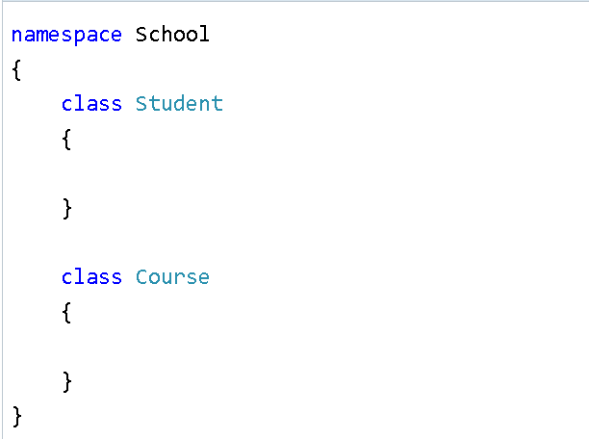
Namespaces
Like a Java Package (determines what you are ‘using’)
Manages related classes
A namespace is created for you when you create a new project (with the name of your project)
Classes under the same namespace can be referred to as namespace. classname syntax. For example, the Student class can be accessed as School. Student

Slide 5
Implicitly Typed Variables
Local variables can be declared with var
Ex. var i = 5;
Used especially when declaring objects in a class.
Ex.
var time = new DateTime() vs DateTime time = new DateTime()
Do we really need to have DateTime in 2 places?
The C# compiler will infer the type from the right part of the statement. Hence, a value must always be assigned to the variable

Slide 6
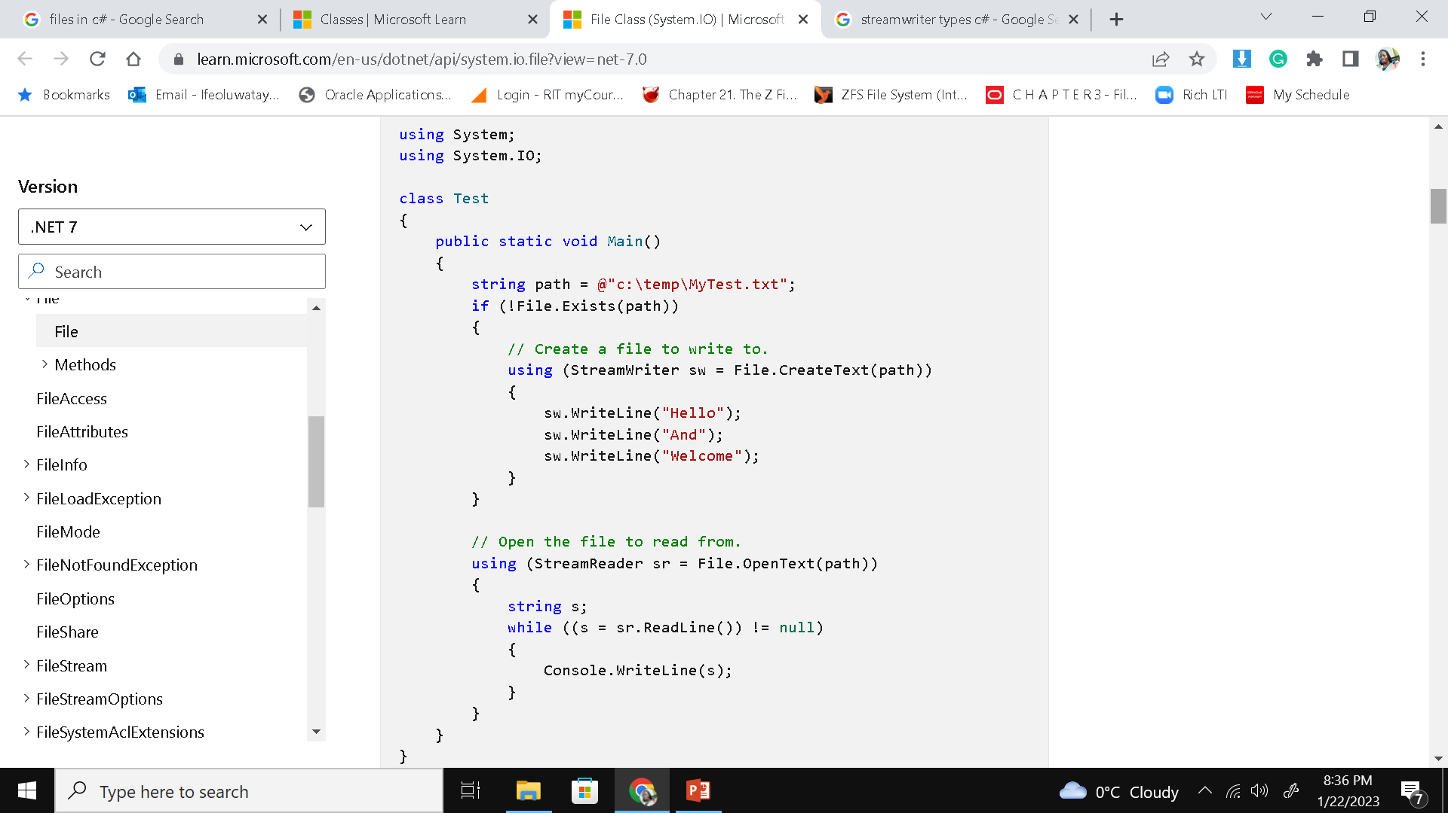
Accessing Files
File is a static class that provides different functionalities like a copy, delete, check if a file exists, append lines or text to a file's content, get last access time, etc
Namespace is System.IO
Works equally well on Linux/Mac/Windows
Can handle any file format.
using (StreamWriter writer = new StreamWriter(“filename.txt"))

Slide 7
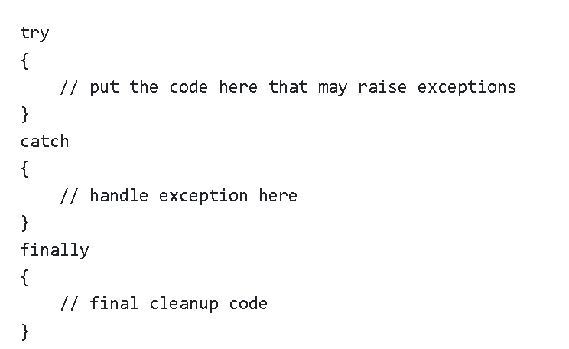
Exception Handling
C# provides built-in support to handle the exception using try, catch & finally blocks
Any suspected code that may raise exceptions should be put inside a try block
Catch identifies and catches specific exceptions such as Array Index Out Of Range or prompting the user to enter a new file name when you catch a FileNotFoundException object
The finally block will always be executed whether an exception is raised or not.
Is used to release resources, e.g., to close any stream or file objects that were opened in the try block
A try block without a catch or finally block causes a compiler error.

Slide 8
Networking in C#
System.Net and System.Net.Sockets Namespaces are used for networking programming in C#
System.Net has very robust classes such as DNS, HttpListener, IPEndPoint etc.
Will learn more in week 6 and 7.

Slide 9
Code Sample 1:“Demo1”
Hello world
Created with dotnet new console
Run with “dotnet run” in directory with .csproj and Program.cs file
Prints hello world to the console

Slide 10
Code Sample 2: “Demo2”
Gets a directory listing of the current directory
Prints out file information
Size
Last Write Time
Filename

